Slide 1
Elevator
Theory of Automata & Formal Languages
Group:
Nashra Ghaffar CT-20032
Abdul Rafay CT-20012
Anas bin Azim CT-20090
Mustafa Munir CT-20302

Slide 2
TABLE OF CONTENTS
01
03
02
04
DEFINITIONS
Working
Elevator & NFA
Working of elevator
using NFA
EXPLAINATION
RealWorld
Application
Explanation of process
with assumptions
Use of elevator

Slide 3
ELEVATOR
An elevator or lift is a cable-assisted, hydraulic cylinder-assisted, or roller-track assisted machine that vertically transports people or freight between floors, levels, or decks of a building, vessel, or other structure.
FINITE AUTOMATA
A finite state machine is a mathematical model of computation. It is an abstract machine that can be in exactly one of a finite number of states at any given time.
NFA
Non-Deterministic Finite Automata
Finite automata are called NFA when there exist many paths for specific input from the current state to the next state.

Slide 4
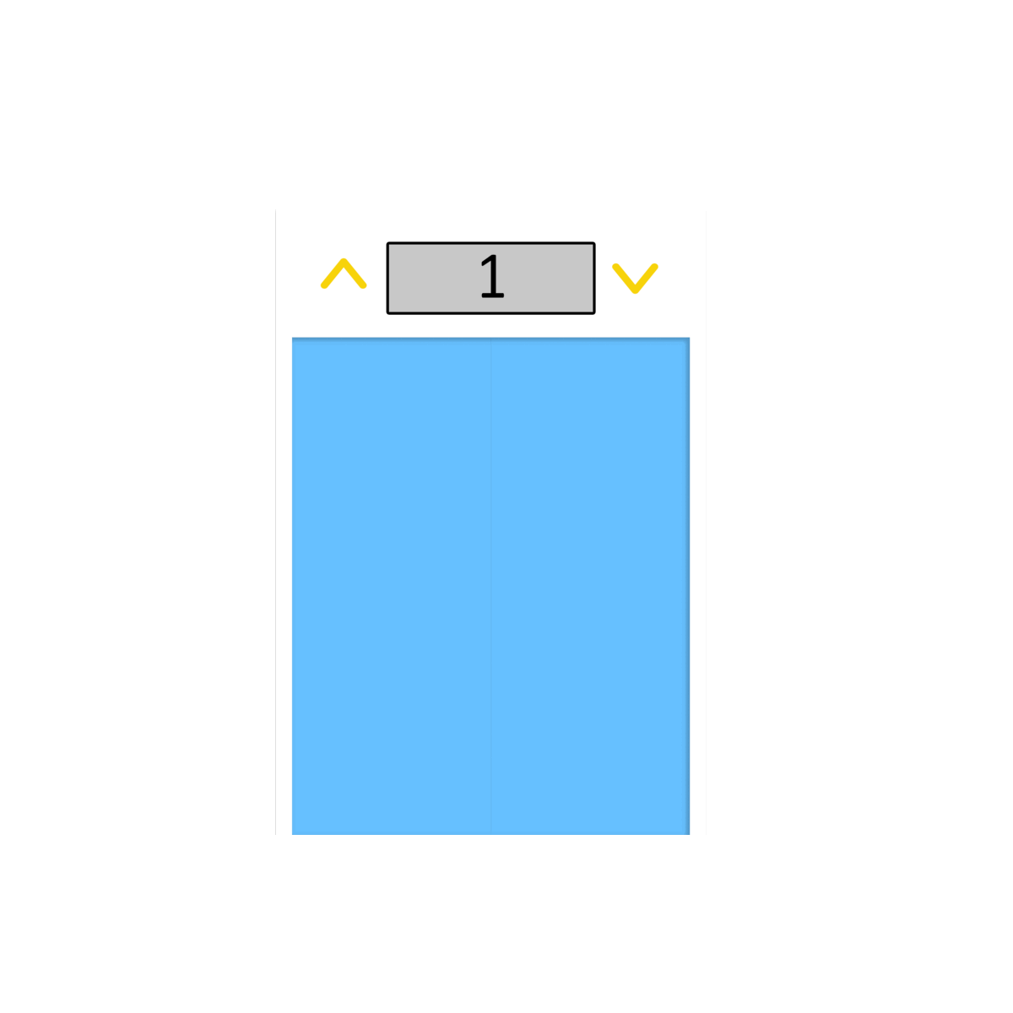
Working Of Elevator
The elevator will initially be in the rest state where the doors are open.
As soon as we select a floor, gate will close now we have transitioned to closed door state.
Now the lift will either move up or move down, according to the selected floor.
While moving upward/downward, we can select floors again, and these floors will be added in the queue.
As the elevator stops it will then transition to arrived state & the door opens.
If there is a next floor selected (stored in the queue), the elevator’s gate then again closes, transitioning towards closed door state, and if there is no floor selected then we can also select the floors at this state.

Slide 5
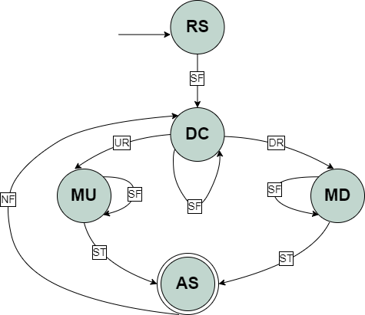

NFA of Elevator
Rest State | RS
Door Closed | DC
Moving Up | MU
Moving Down | MD
Arrived State | AR
Down Request | DR
Up Request | UR
Select Floor | SF
Next Floor | NF
Stopping | ST
SF

Slide 6















Testing of Elevator with Accepted String
SF
SACCEPTED = { SF DR SF ST NF UR ST , …}

Slide 7
Transition Table

Slide 8

Assumptions
Select Floor Input cannot be equal to Current Floor.
The floors added in the queue will be sorted. Let suppose the elevator is moving towards floor 5 and a new entry of floor 3 is done in the queue, so it will first go to floor 3 and then floor 5.
Selecting a floor on Arrived State will add the floor in the queue, and NF will pick the first floor from the queue and transition to door closed state.
DFA is not applicable according to the workflow of this elevator.
Tuples
Input Symbols Σ = { SF, UR, DR, ST, NF }
Initial State → +Rest State (RS)
Final State -Arrived State (AR)
States = { RS, DC, MU, MD, AS }
SACCEPTED = { SF DR SF ST NF UR ST, … }
SREJECTED ={ SF UR NF, … }

Slide 9
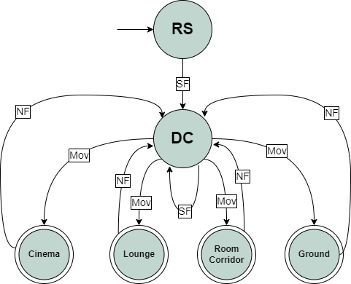



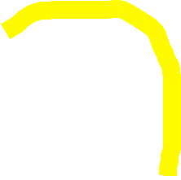

Real world use of Elevator
Shopping Mall
Rest State | RS
Door Closed | DC
Select Floor | SF
Moving | Mov
Next Floor | NF
Ground
1st Floor
Food Court
Cinema
SF
SF
SF
SF

Slide 10
QUESTIONS ?
If any, feel free to ask.

Slide 11

